Slide 1




Defence Force Database Management System
Group - 5

Slide 2
Group Members
Abhishek Yadav (2020BCS-003)
Aditya Kumar Singh (2020BCS-004)
Pratham Singh (2020BCS-059)
Mark Verma (2020BCS-078)
Saahil Sabu Hameed (2020BCS-079)

Slide 3
Contribution
Listing all the features, making flowchart for implementation and deciding upon classes
Aditya Kumar Singh (2020BCS-004)
Abhisekh Yadav (2020BCS-003)
Mark Verma (2020BCS-078)
Deciding classes, implementation and coding
Aditya Kumar Singh (2020BCS-004)
Abhisekh Yadav (2020BCS-003)
Mark Verma (2020BCS-078)
Pratham Singh (2020BCS-059)
Saahil Sabu Hameed (2020BCS-079)
Formatting the output and preparing report and presentation
Aditya Kumar Singh (2020BCS-004)
Pratham Singh (2020BCS-059)
Saahil Sabu Hameed (2020BCS-079)

Slide 4
Contents
Introduction
Description
Classes and other entities involved
Inheritance Order
Permissions to different personnel
Global functions used
Output
Conclusion

Slide 5
Introduction
This project gives a peek into the inner structure of the Defence Forces Database.
Using the concept of Object-Oriented Programming, it solves confidentiality issues and provides fast and organised access of information to various ranks of soldiers and administrator(s).
Different ranks of soldiers will be given view access to various depths of the database. Generals will also be given write privileges to add or remove a soldier.

Slide 6
This project shall make use of the following:
Data Encapsulation
Data Abstraction
Data Hiding
Inheritance
Polymorphism (Operator Overloading)
File Handling
Other OOPL features

Slide 7
Application of OOPL features
In any class, the data members and getter/setter functions are bonded together exhibiting data encapsulation.
The user interface has various modes which provide all in one interface to all the ranks of defence forces. Users can access the legible information using their username and password. The private, protected and public access specifiers are core to the data hiding property.

Slide 8
The concept of inheritance is used to increase the code reusability and transitivity and communication between various classes such as the Lieutenant class is inherited from the sepoy class and so on.
Using the property of inheritance and data encapsulation confidentiality is maintained between soldiers and generals while also streamlining data and maintaining organisation. It also helps in weapon management.
Basically, Inheritance provides the skeleton to this project over which other OOP properties are implemented.
Data File Handling is used to store the the snapshot of the database.

Slide 9
Description
This project will help to maintain and access the details of the military personnel.
Firstly, there will be a personal dashboard. It will ask the user for their username and password for authentication.
If the password is correct, or personal dashboard of the user will be displayed and they will be given a choice to change the password or exit.

Slide 10
When the user enter their username and password, we will know their position and accordingly they will be given access.
For army, Sepoy, lieutenant,major and general form a multilevel inheritance where general is derived from class major, major is derived from class lieutenant and leiutenant is derived from class sepoy.
Similarly, air chief marshall, squadron leader, flight lieutenant and aircarftman form the multilevel-inheritance for airforce.
There will also be other classes such as chief of defence staff, date, war, sections for army and airforce, etc to make the program more accessible.

Slide 11
Member functions will be used to add, delete, modify details for tasks like logging in, hiring, retiring of personnels.
Starting from the main menu, the user can choose their military squad. This will lead them to their proper squad as selcted and then they can log in using correct credentials.
This will help to maintain privatization of data for all and accessibility to the selected people with the application of OOPL.

Slide 12
Used Classes
Sepoy → Lieutenant → Major →Army General (Multi-level Inheritance)
Aircraftman → Flight Lieutenant → Squadron Leader → Air Chief Marshal (Multi-level Inheritance)
Chief of Defence Staff (CDS) which is friend class of Army General and Air Chief Marshal
section_army → stores the information related to one section of army like number of soldiers in an army section and number and types of different weapons
section_airforce → stores the information related to one section of army like number of soldiers in an army section and number and types of different weapons
War → to stores the information related to war like start date, end date, casualties, etc.
class date → To store date information we use this user-defined data type

Slide 13
Entities of the classes:
Classes related to army:
Class sepoy
This is the represents the lowest army rank and various features of this class are:-
Data Members
string sepoy_id
string Name
date date_of_birth //date is a used defined data type (class)
date date_of_joining
string Password
string sepoy_section_id

Slide 14
Member Functions
void getter() — a generalised function to input some data members of sepoy
void getter_sepoy() — to take input into the sepoy object
void display() — a generalised function to display some data members of sepoy
void display_sepoy() — to display the sepoy object to user
void modify() — a generalised modify some data members of sepoy object
void modify_sepoy() — to modify the sepoy object
Other Utilities functions
void set_password(string pass)
string get_password()
string ret_sep_id()
string ret_sep_name()
int ret_sepoy_sec_id()

Slide 15
• Class Lieutenant
This is a derived class from class sepoy using public visibility mode. This is the second lowest army rank involved in this project. He is the head of an army section. The various features of this class are as follows:-
Data Members
String lieutenant_id
String section_id
Other inherited data members like string name, string password from base class sepoy
Member Functions
void getter_lieutenant()
void display_lieutenant()
string ret_lieu_id()
void modify_lieutenant()

Slide 16
• Class Major
This is a derived class from class lieutenant using public visibility mode. This is the second highest army rank involved in this project. He is the head of a company. The various features of this class are as follows:-
Data Members
string major_id
string company_id
Other inherited data members
Member Functions
void getter_major()
void display_major()
string ret_maj_id()
void modify_major()

Slide 17
• Class General
This is a derived class from class major using public visibility mode. This is the highest army rank involved in this project. He is the head of the entire army. Chief of Defence Staff(CDS) is the friend class of this class. The various features of this class are as follows:-
Data Members
string general_username
Member Functions
void getter_general()
void display_general()
string ret_gene_username()
string ret_gen_name()

Slide 18
• Class section_army
This is not a derived class. It represents the group of sepoys(lowest rank army personnel). There are 6 sections considered in this project viz. sec1, sec2, sec3,…, sec6. sec1 to sec3 are in company named com1 and sec4 to sec6 are in company named com2. Lieutenant is the head of an army section. The various features of this class are as follows:-
Data Members (all in protected mode)
unsigned num_sepoys
string section_id
string lieutenant_id
unsigned num_gun
unsigned num_tank
unsigned num_mortar
unsigned num_combat_shotgun
Member Functions (all in public mode)
void operator++(int) //operator overloading
void getter_section_army()
void print_Section_info()
void print_section_weapon_info()

Slide 19
Classes related to Air Force Class Aircraftman This represents the lowest airforce rank and various features of this class are:-
Data Members
string aircraftman_id
string name
date date_of_birth
date Date_of joining
string password
string airman_section_id

Slide 20
Member Functions
void getter()
void getter_aircraftsman()
void display
void display_aircraftman()
void set_password(string pass)
string get_password()
string ret_air_id()
int ret_aircraftman_sec_id()
void modify()
void modify_aircraftman()

Slide 21
• Class flight_lieutenant
This is a derived class from class aircraftman using public visibility mode. This is the second lowest airforce rank involved in this project. He is the head of an airforce section. The various features of this class are as follows:-
Data Members
string flight_lieu_id
string section_id
Other inherited data members like string name, string password from base class aircraftman
Member Functions
void getter_flight_lieutenant()
void display_flight_lieutenant()
string ret_fli_lieu_id()
void modify_flight_lieutenant()

Slide 22
• Class squadron_leader
This is a derived class from class flight_lieutenant using public visibility mode. This is the second highest airforce rank involved in this project. He is the head of a squadron. The various features of this class are as follows:-
Data Members
string squadron_leader_id
string squadron_id
Other inherited data members
Member Functions
void getter_squadron_leader()
void display_sqa_leader()
string ret_sqdl_id()
void modify_sqd_leader()

Slide 23
Class section airforce
This is not a derived class. It represents the group of aircraftman(lowest rank airforce personnel). There are 6 sections considered in this project viz. sec1, sec2, sec3,…, sec6. sec1 to sec3 are in squadron named sqa1 and sec4 to sec6 are in squadron named sqa2. Lieutenant is the head of an army section. The various features of this class are as follows:-
Data Members
unsigned num_aircraftman
string section_airforce_id
string flight_lieu_id
unsigned num_missile
unsigned num_fighter_jet
unsigned num_mp5_machine_gun
unsigned num_attack_helicopter
Member Functions (all in public mode)
void operator++(int) //operator overloading
void getter_section_airforce()
void print_section_info()
void print_section_weapon_info()

Slide 24
Other Classes
• Class war
This class represents a war. One object of this class contains all the information related to a war.
Data Members (all in private mode)
date war_start_date
date war_end_date
string location
string opposition
unsigned num_our_casualties
unsigned num_theirs_casualties
unsigned expenditure
string result
Member Functions (all in public mode)
Void getter_war()
display_war()

Slide 25
• Class cds
Chief of Defence Staff(cds) is given the permission of only viewing all the details of army and airforce along with the war details. A cds is the head of both the army and airforce in this project.
It is friend class of both class general and class air_chief_marshall. It has not inherited any class.
Data Members (all in private mode)
string cds_id
string name
string username
string password
date date_of_birth
date date_of_joining
Member Functions (all in public mode)
void getter_cds()
void display_cds()
string ret_username_cds()
void set_password_cds()
string ret_password_cds()

Slide 26

Inheritance Order
For Army:-
Sepoy
Lieutenant
Major
General

Slide 27
For Air Force:-
Aircraftman
Flight Lieutenant
Squadron Leader
Air Chief Marshall

Slide 28
Permissions to personnels
Sepoy
He can login to his dashboard to view his profile
Change his current password
View section wise weapon allocation
Lieutenant
He can login to his dashboard to view his profile
Change his password
View section wise weapon allocation

Slide 29
Army General DEFAULT USERNAME: vikrambatra DEFAULT PASSWORD: 1234
He can login to his dashboard to view his profile
Change his password
View section wise weapon allocation
He can add/modify/delete the record of any one of sepoy/lieutenant/major
He can view and add war details
Can’t view the details the airforce officers

Slide 30
Aircraftman
He can login to his dashboard to view his profile
Change his current password
View section wise weapon allocation
Flight Lieutenant
He can login to his dashboard to view his profile
Change his password
View section wise weapon allocation
Squadron Leader
He can login to his dashboard to view his profile
Change his password
View section wise weapon allocation

Slide 31
Air Chief Marshal DEFAULT USERNAME: vrchaudhari DEFAULT PASSWORD: 1234
He can login to his dashboard to view his profile
Change his password
View section wise weapon allocation
He can add/modify/delete the record of any one of sepoy/lieutenant/major
He can view and add war details
Can’t view the details the army officers

Slide 32
Chief of Defence Staff DEFAULT USERNAME: bipinrawat DEFAULT PASSWORD: cds Name : Bipin Rawat Date Of Birth : 8-9-1978 Date Of Joining : 7-6-1999
He can login to his dashboard to view his profile
Change his password
View all details related to army except passwords
View all details related to airforce except passwords
View the war details
View the section wise weapon allocation details

Slide 33
Global Functions
Functions used for army
void add_user(void); //temporary function used to populate the .bin files
void add_army_section_detail(void);
void army_field(void);
void sepoy_login(void);
void lieu_login(void);
void major_login();
void general_login(void);
void add_personel(string post_name);
void modify_personel(string post_name);
void delete_personel(string post_name);
void army_personal_dashboard(void);

Slide 34
Functions for airforce
void add_airforce_user(); //for temporary adding airforce personel
void add_airforce_personel(string post_name);
void airforce_field();
void air_personal_dashboard(void);
void flight_lieu_login();
void squad_leader_login();
void air_chief_marshal_login();
void aircraftman_login();
void modify_airforce_personel(string post_name);
void delete_airforce_personel(string post_name);
void add_airforce_section_detail(void);

Slide 35
Functions related to war
void war_details(void);
void display_war_history();
void add_war_details(void);
CDS
void add_cds_details(void);
void cds_login(void);
void cds_field(void);
Utility functions
void main_menu(); //handles the Super_Menu

Slide 36
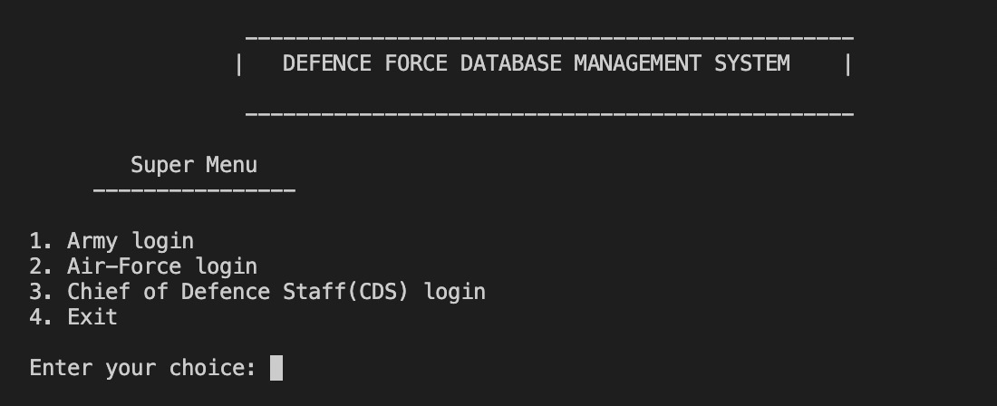
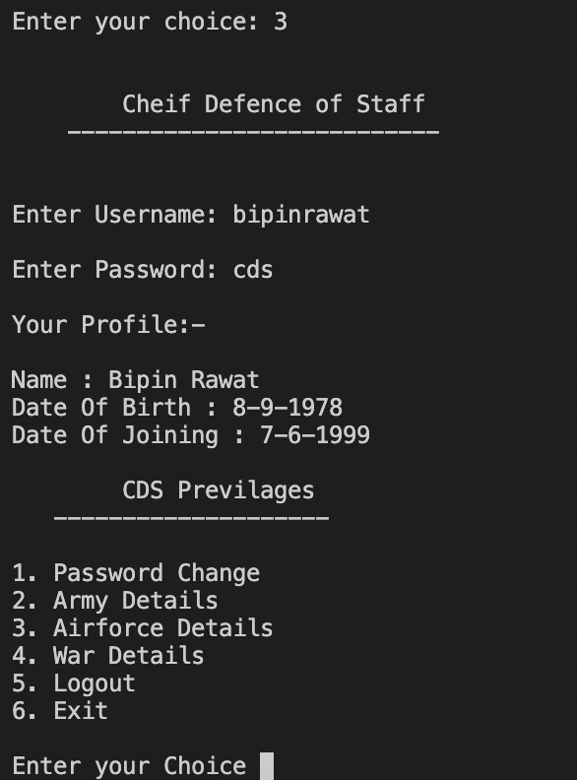
Output
Super_Menu – when the program is run Option 3 for CDS

Slide 37
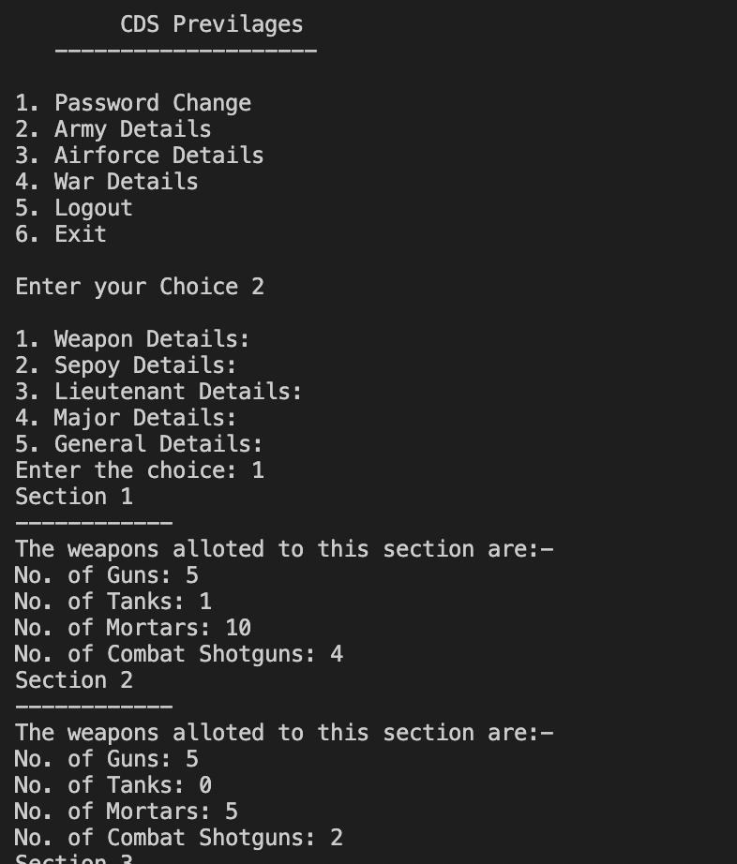
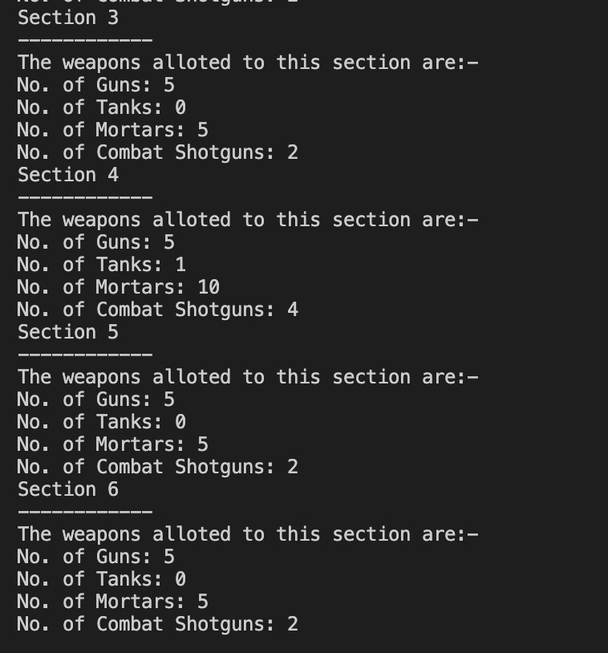
Option 3 for CDS
Selecting one by one various options

Slide 38
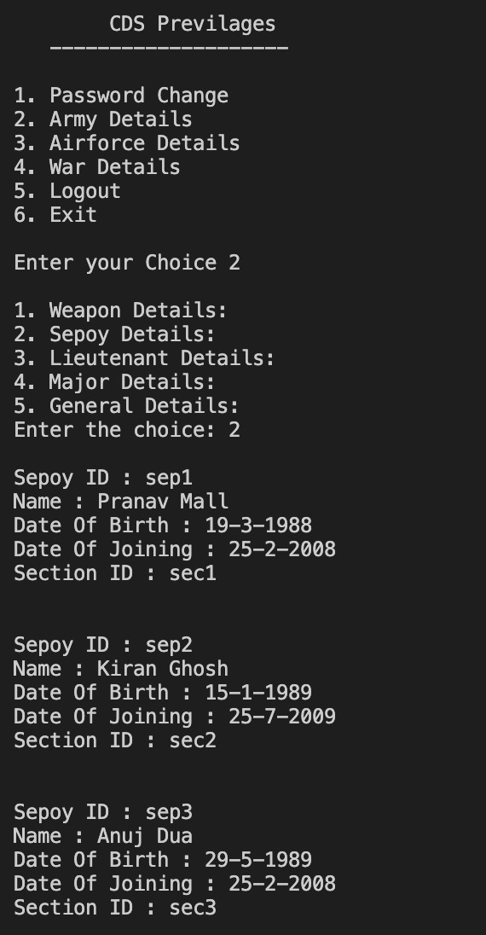
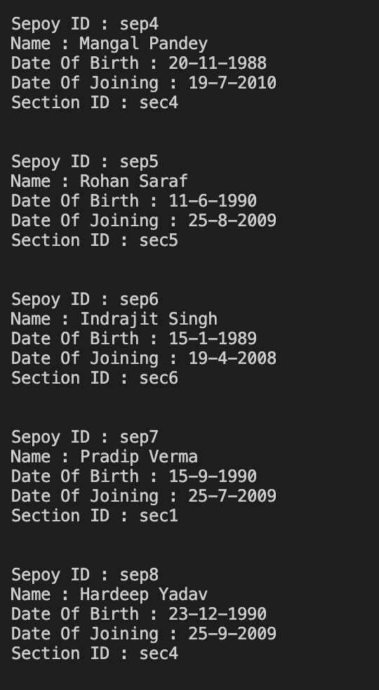
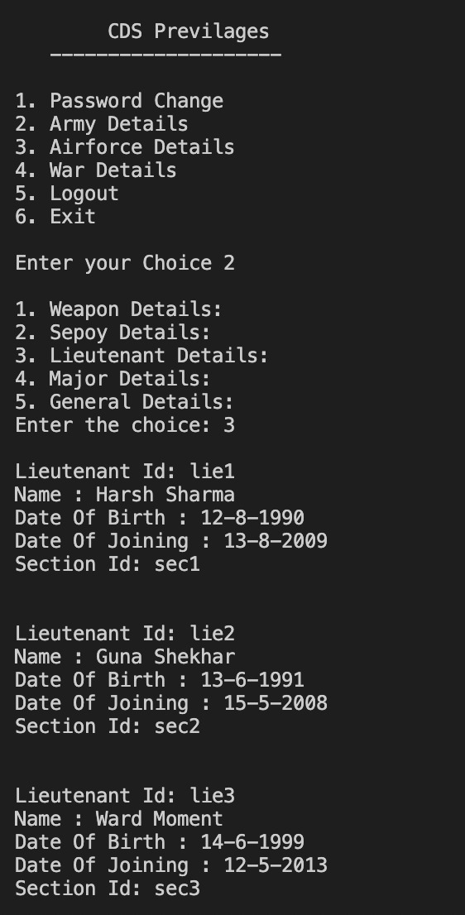

Slide 39
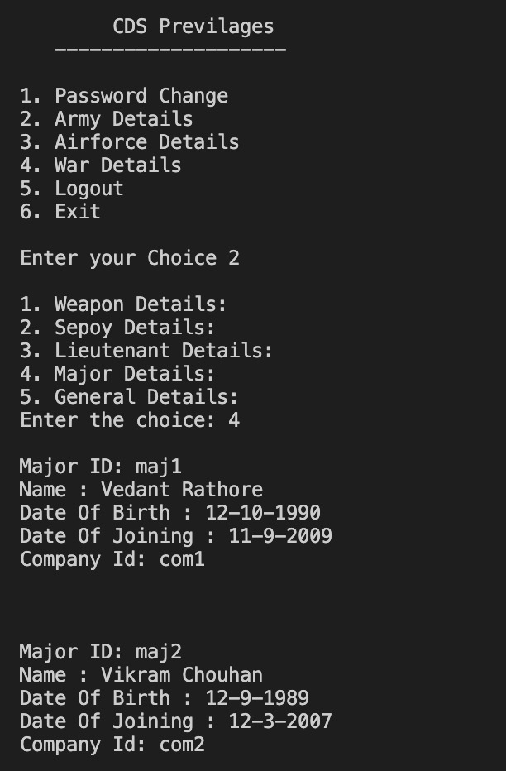
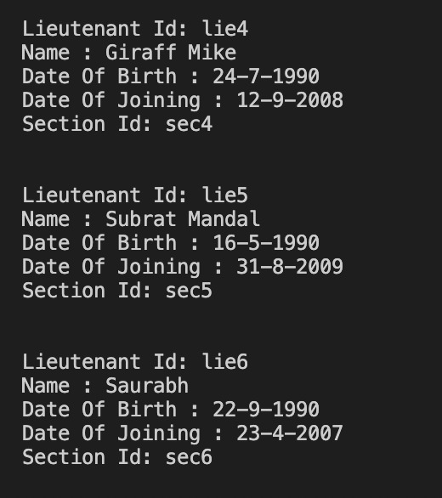

Slide 40
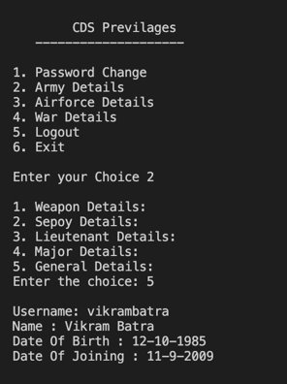
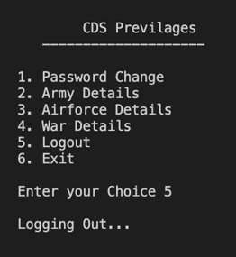

Slide 41
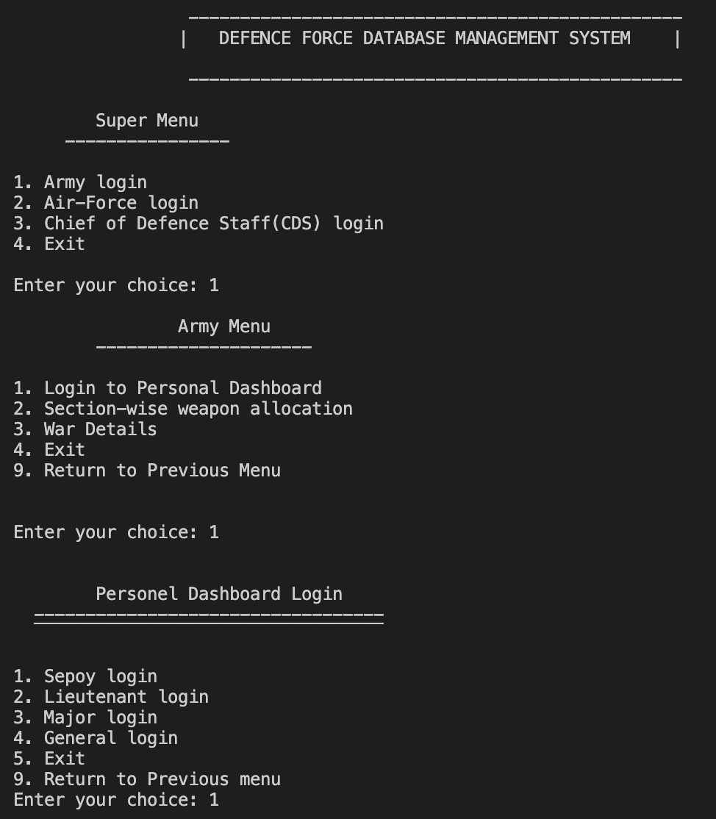
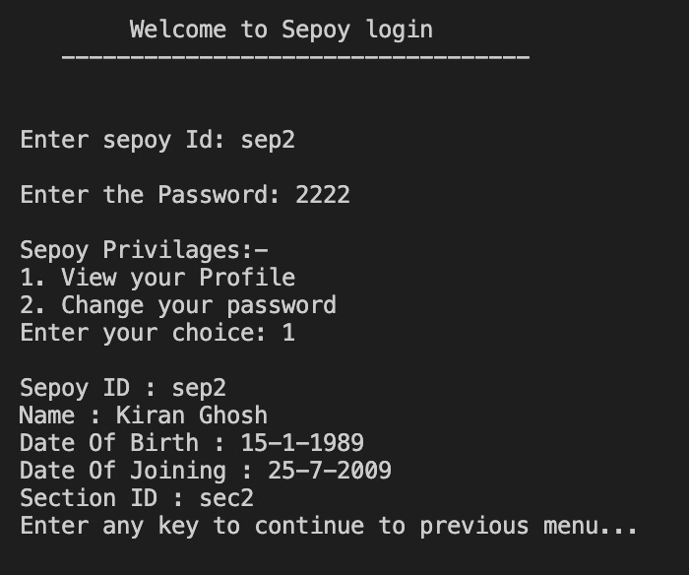
Choosing option 1 for army details – Army Personnel
Then choosing various options one by one

Slide 42
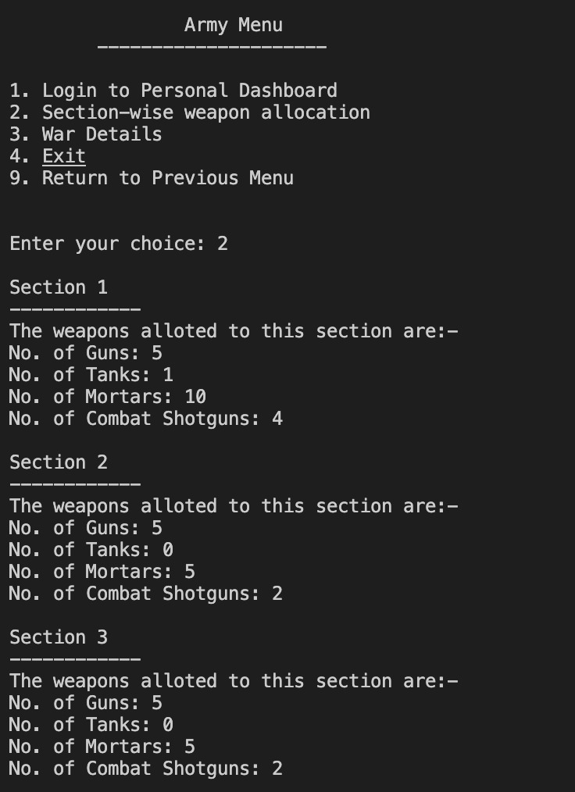
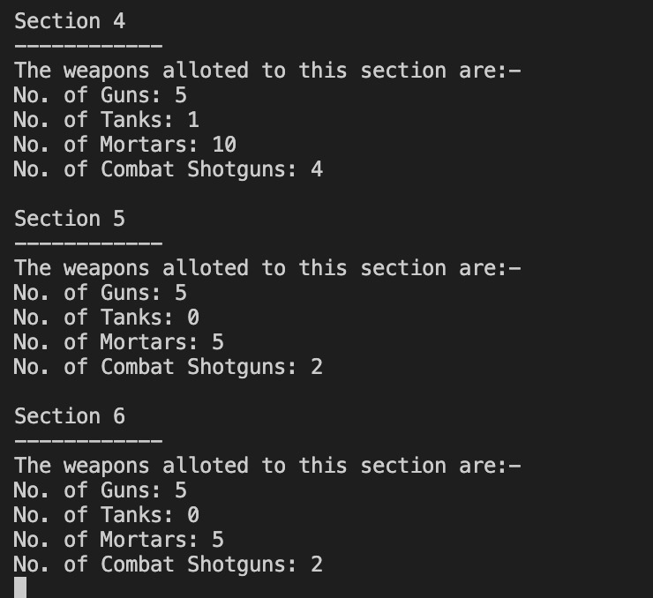

Slide 43
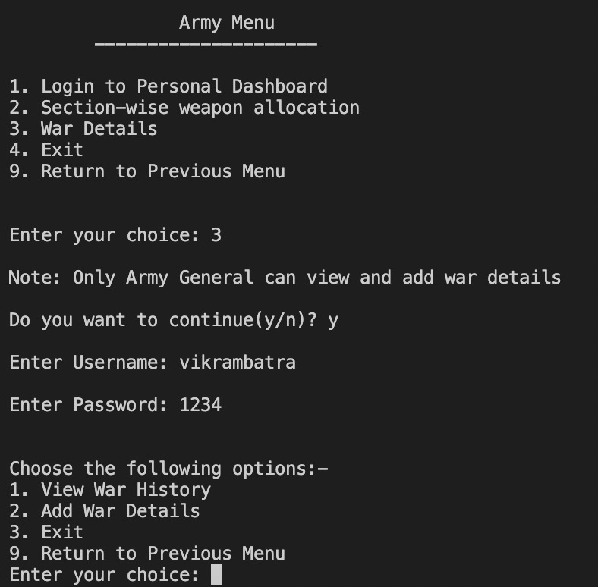
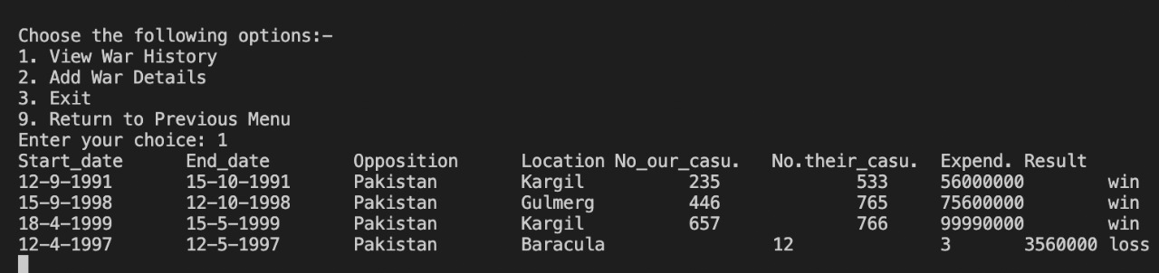

Slide 44

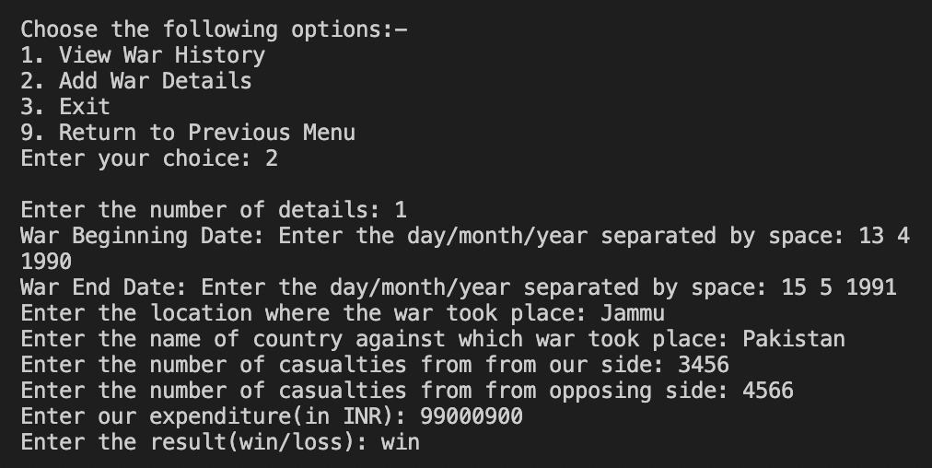

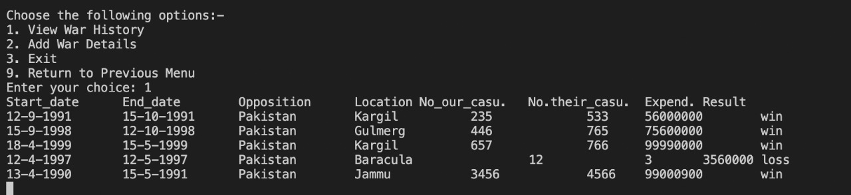
Adding a war detail

Slide 45
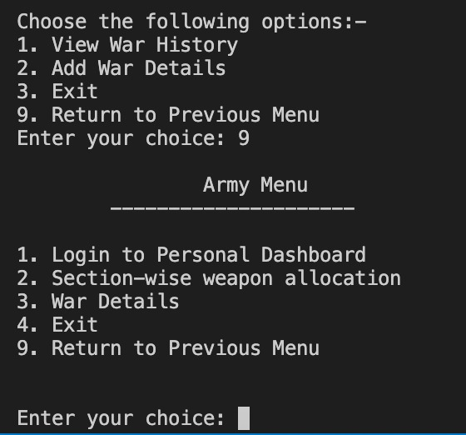
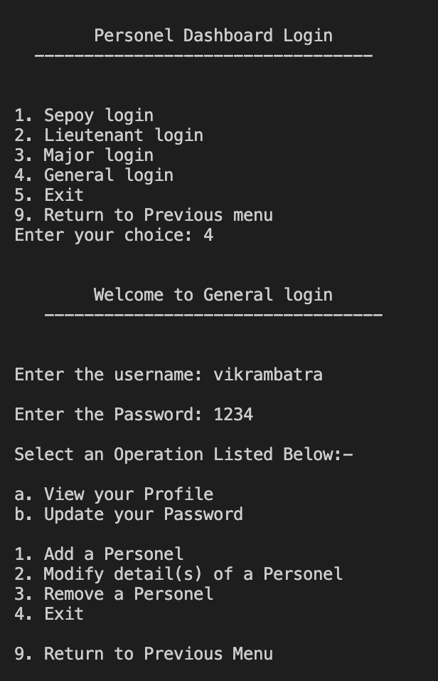

Slide 46
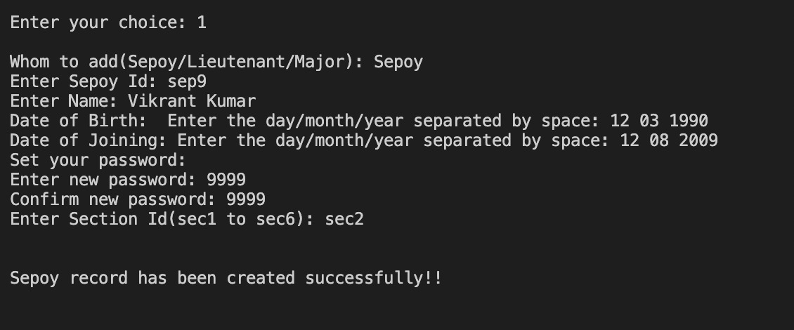
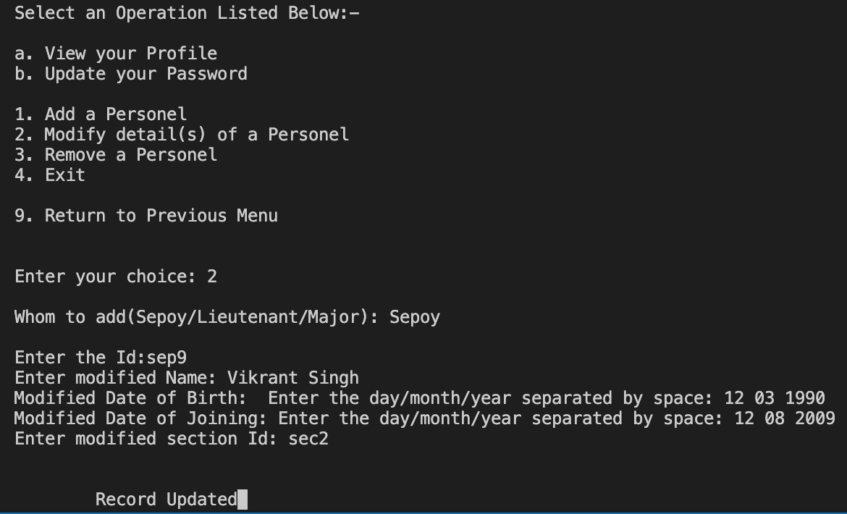
Adding a sepoy detail Updating a sepoy detail

Slide 47
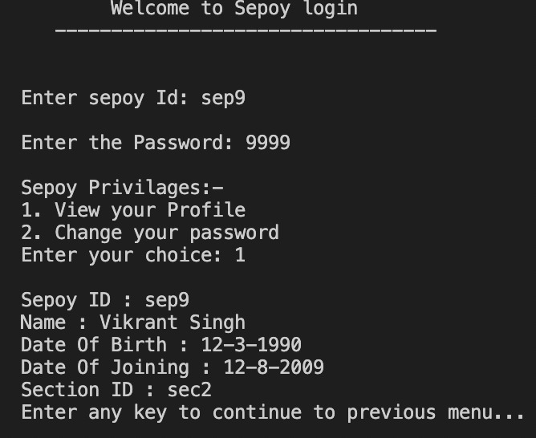
Checking for modification

Slide 48
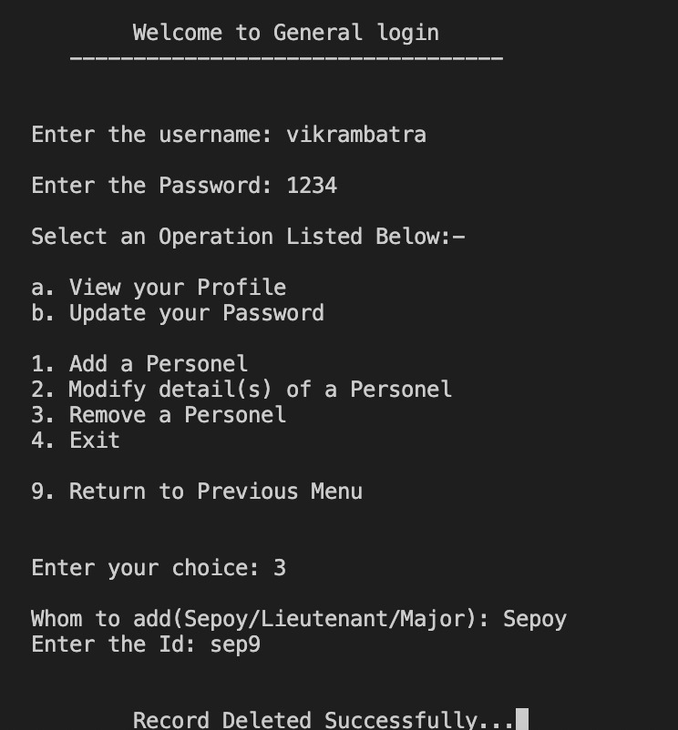
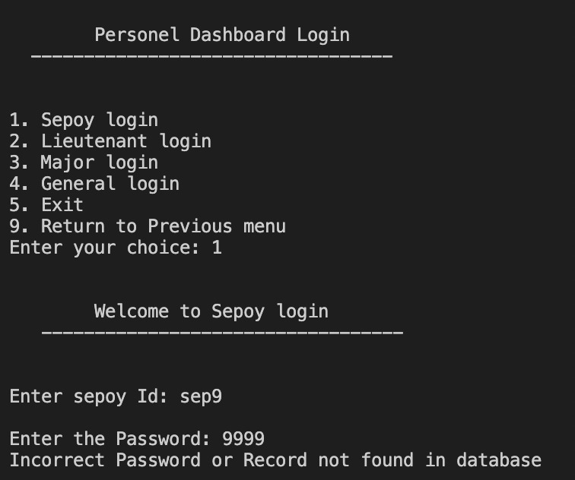
Deleting a sepoy record Checking if record is deleted or not
Similarly, we can get the output for Airforce as well.

Slide 49
Conclusion
This project gives a peek into the Defence Force Database Management System. It uses the Object Oriented Programming concepts to maintain confidentiality between various ranks of defence personnel while also streamlining the information access privileges.

